Slide 1

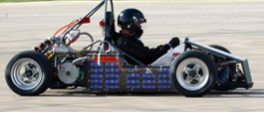
Team 505: SAE Hybrid Vehicle Battery Box and Battery Management System
28-March-19

Slide 2






Team Introductions
William Pisani
Cooling Specialist
Raymond Klouda
Impact Engineer
Thomas O’Neill
Project Manager
Christopher Fishman
BMS Engineer
Christian Gaya
Battery Engineer

Slide 3



Sponsor and Advisor
Sponsor Liaison
Michael Hays
Technical Specialist at Cummins
Academic Advisor
William Oats, Ph.D.
FAMU-FSU College of Engineering Professor
Christian Gaya

Slide 4
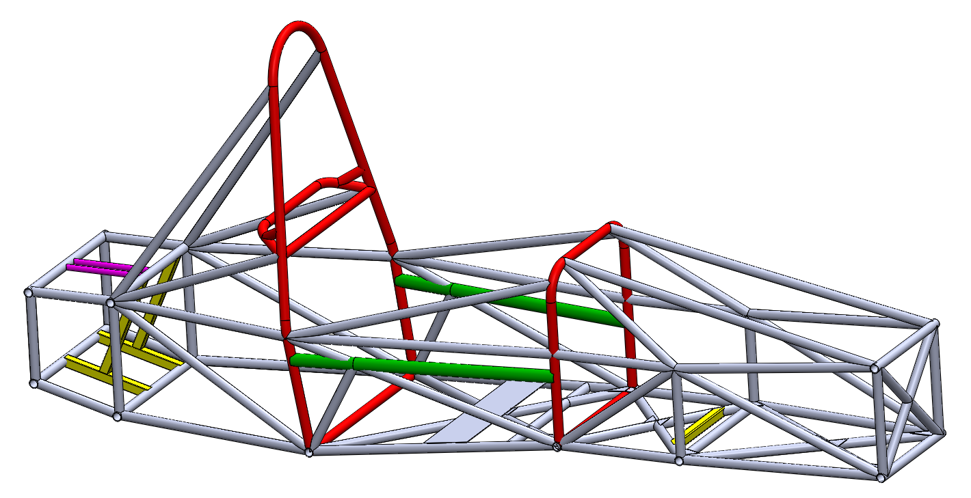

Objective
Design a battery box and battery management system (BMS) for the SAE hybrid vehicle competition team.
Christian Gaya

Slide 5

Customer Needs
Interpreted Needs
  Design a program that takes in parameters about motors and outputs information about the battery system.
  The battery box protects the battery, prevents overheating, and avoids environmental impact.
  A small-scale prototype should be created with proper specifications.
  BMS maintains charge control, cell balancing, and monitors power input and output.
  Battery system for a momentary high-torque boost should be a focal point of the BMS system.
  The battery box and BMS both adhere to SAE competition guidelines.
Christian Gaya

Slide 6

Functional Decomp
Battery System
Battery Containment
Battery Management System
Support
Monitor
Integrate
Configure
Control
External Forces
Battery Load
Vehicle Chassis
Battery Layout
Temperature
Control
Charge
Current Flow
Voltage Level
Power Output
Batteries
Temperature
Christian Gaya

Slide 7
Functional Decomp
Battery Containment
Support
Integrate
Configure
Control
External Forces
Battery Load
Vehicle Chassis
Battery Layout
Temperature
Christian Gaya

Slide 8
Functional Decomp
Battery System
Battery Containment
Battery Management System
Support
Monitor
Integrate
Configure
Control
External Forces
Battery Load
Vehicle Chassis
Battery Layout
Temperature
Control
Charge
Current Flow
Voltage Level
Power Output
Batteries
Temperature
Christian Gaya

Slide 9
Functional Decomp
Battery Management System
Monitor
Control
Charge
Current Flow
Voltage Level
Power Output
Batteries
Temperature
Christian Gaya

Slide 10

Concept Generation
Biomimicry
    Analytically applied our problem to nature and brainstormed nature's own solutions.
Anti-Problem
    Project problems were reversed, and possible solutions to these anti-problems were found.
Morphological Chart
    Lists functions and various mechanisms that can be used to perform the functions listed.
    These Included the ideas we found from biomimicry, anti-problems, and the customer needs.
    Lines were used to connect the rows and columns of the chart. Each line represented a different possible concept.
Raymond Klouda
10

Slide 11

Concept Selection
House of Quality
  Compared customer requirements to engineering characteristics (evaluation criteria).
  Generated the proper evaluation criteria for the Pugh charts.
Pugh Charts
  Determined the most important design concepts based on the evaluation criteria through comparing each concept to a datum.
Analytical Hierarchy Process
  A more “Mathy” way to make a decision compared to Pugh Charts.
  Equations were used for each evaluation criteria and design concept.
Raymond Klouda

Slide 12

Finite Element Analysis (FEA)
FEA was used to aid in material selection and mounting of the battery box.
The following thicknesses were tested for impact strength and G-loading:
  0.25 inches,
  0.1875 inches, and
  0.125 inches.
The results showed that a thickness of 0.125 inches was sufficient for the battery box.
Thomas O’Neill

Slide 13

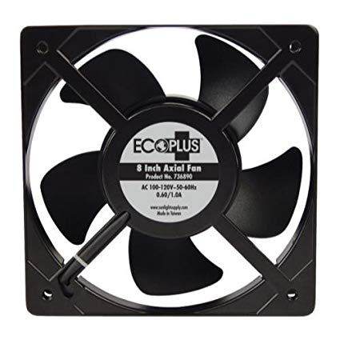
Thermal Analysis
Thermal analysis was performed to maintain safe operating conditions.
The following were calculated:
  Velocity profile,
  Energy consumption,
  Battery operating temperature, and
  Volumetric flow of a fan.
Thomas O’Neill

Slide 14

Velocity Profile
An velocity profile estimation was found using average track speed data and vehicle specifications.
Thomas O’Neill

Slide 15

Embodiment
Complete design of scale model.

Slide 16
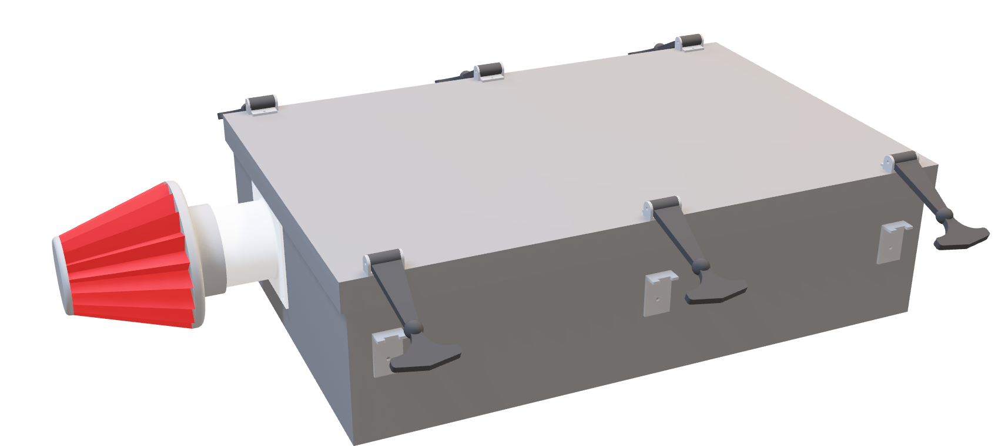
Thomas O’Neill

Slide 17
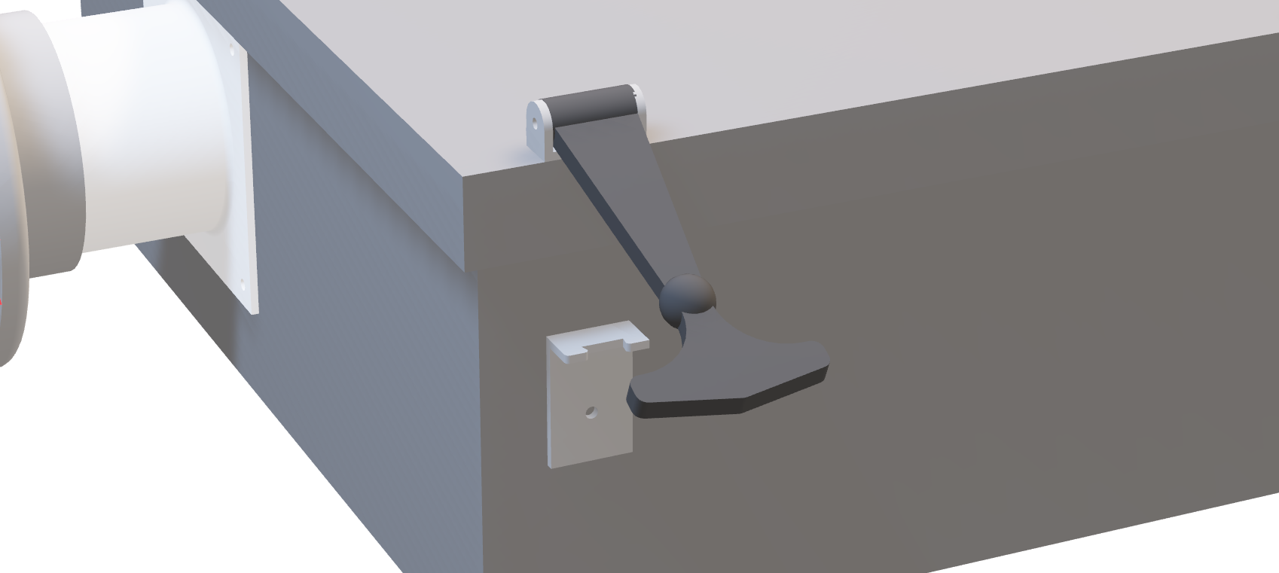
Thomas O’Neill

Slide 18

Thomas O’Neill

Slide 19
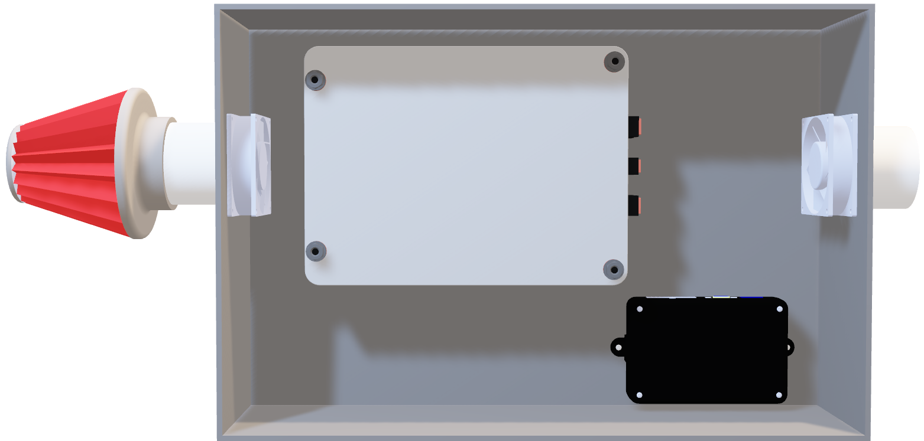
Thomas O’Neill

Slide 20
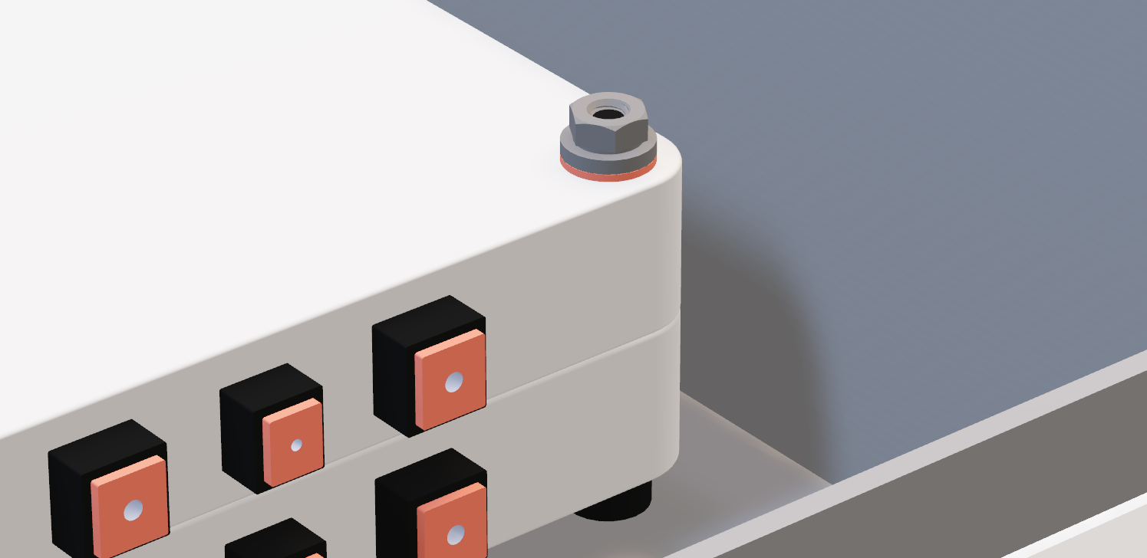
Thomas O’Neill

Slide 21

Manufacturing
Christopher Fishman

Slide 22

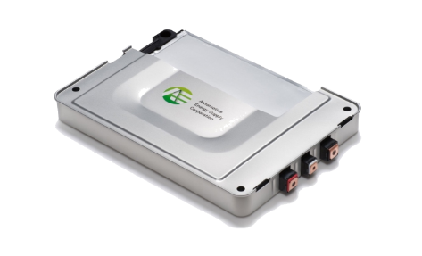
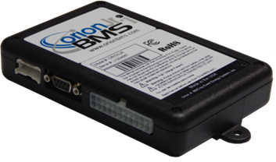
Electrical Components Assembly
Nissan Leaf Modules and Orion Jr. BMS were chosen.
  Components were integrated by following manufacturers specifications for series battery configuration.
The BMS requires 9-60V for operating power.
  2 supplies were used: battery pack and 12 VDC power supply.
  12 VDC power supply was used to emulate a car alternator.
Christopher Fishman

Slide 23
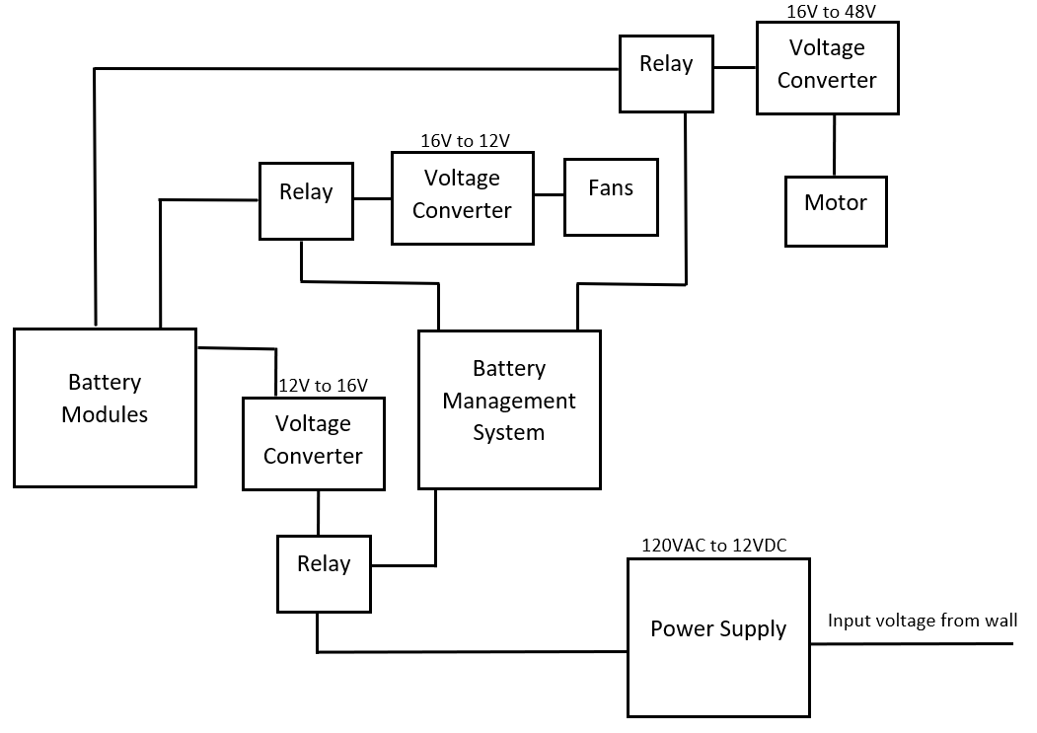
Electrical Schematic
Christopher Fishman

Slide 24

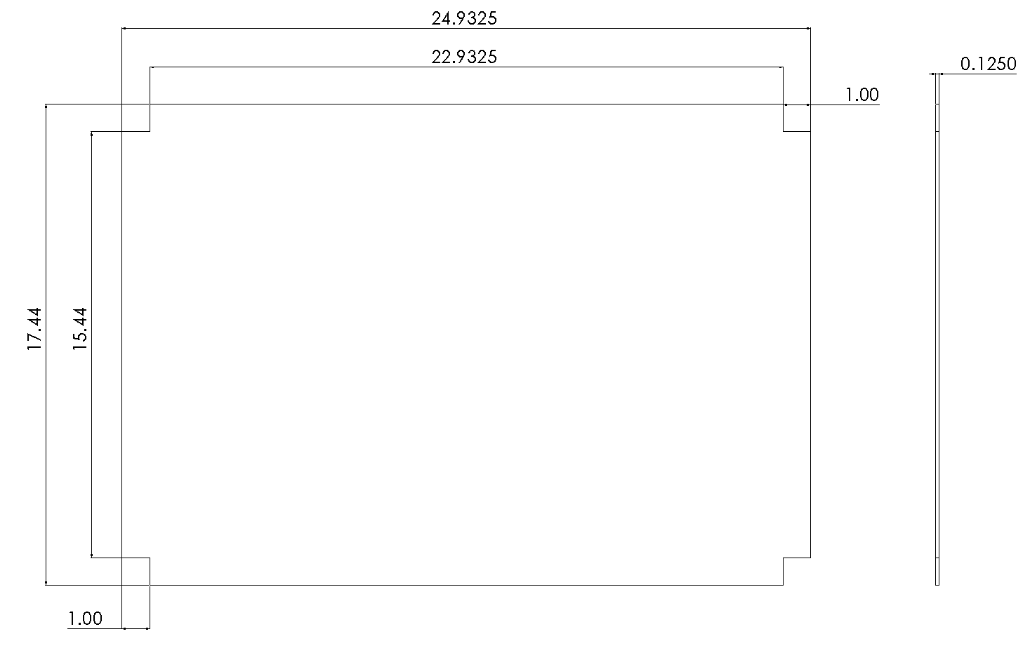
Manufacturing Drawings
Raymond Klouda

Slide 25
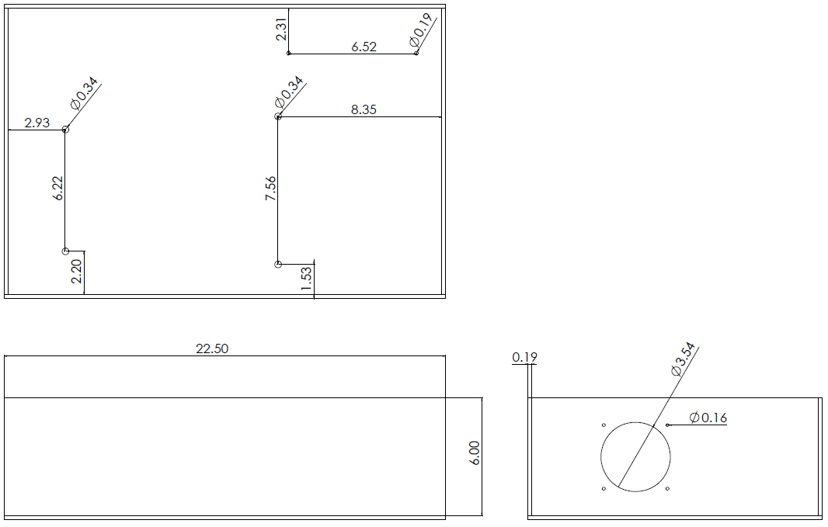
Manufacturing Drawings
Raymond Klouda

Slide 26

Testing
Christian Gaya

Slide 27

Testing Electrical Systems
Discharge characteristics of Nissan Leaf Modules
  Voltage change over time during constant-current discharge.
  Charge life for an individual module was estimated.
  Charge life data was extrapolated for a full-scale battery pack.
Time required to bring modules to full-charge from different voltage levels of the modules
  After being discharged, the batteries were connected to a charging circuit and the results were monitored.
Temperature monitors
  Thermistors were tested in controlled-climate conditions to ensure accuracy.
Christian Gaya

Slide 28

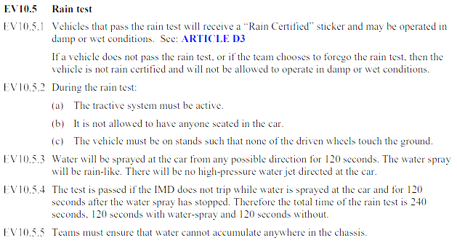
Testing the Battery Box
Thomas O’Neill

Slide 29
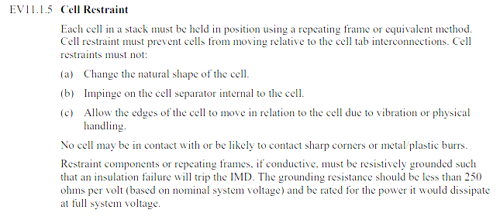
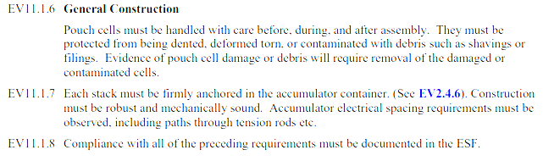
Testing the Battery Box
Thomas O’Neill

Slide 30

Most Important Points
Small-scale model is functional.
The battery box adequately protects the components.
The battery system meets SAE competition guidelines.
Worth considering alternate battery sources other than Nissan Leaf modules. Ex. Battery pack constructed from 18650 cells.
Christopher Fishman

Slide 31

Lessons Learned
Small vendors can be difficult when it comes to meeting deadlines.
Thorough understanding of the functionality of your components is critical to proper implementation; always read through manuals and documentation.
Expect delays beyond the delays that are already accounted for.
Christopher Fishman

Slide 32
Reference
Motors. (n.d.). Retrieved February, 2019, from http://www.evwest.com/catalog/index.php?cPath=8
Fuel Economy Retrieved February, 2019, from https://www.fueleconomy.gov/feg/hybridtech.shtml.
800hp Electric Pickup Retrieved February, 2018, from https://www.hardworkingtrucks.com/rivian-reveals-chassis-of-800-hp-electric-pickup/
2019 Formula SAE Rules. Retrieved February, 2019, from https://formula-hybrid.org/wp-content/uploads/2019-Formula-Hybrid-Rules-Rev-0.pdf

Slide 33
Questions

Slide 34
Backup Slides

Slide 35
Functional Decomp Backup

Slide 36
Customer Needs Chart
Question/Prompt ​ | Customer Statement ​ | Interpreted Need ​
Should we build a battery box specific to the current SAE hybrid vehicle? ​ | I want to be able to provide parameters about the battery that the box is holding and get values returned about the size of the box. ​ | A program should take parameters about a battery and output parameters about a battery box. ​
Should a physical model of the battery box be built? ​ | The main item I'm looking for is the program that will give me values based on the battery. ​ | The main item I'm looking for is the program that will give me values based on the battery. ​
What should the battery box protect from? ​ | The container should be waterproof, thermally insulated,and environmentally sustainable. ​ | The battery box protects the battery. Thebattery box prevents overheating of the battery. The battery box does notnegatively impact the environment. ​
What should the BMS do? ​ | The BMS will maintain charge control and cell balancing of thebattery in a safe and efficient manner while also monitoring power input and output. ​ | BMS maintains charge control, cell balancing, and monitors power input and output. ​
What battery are we using to create a BMS for? ​ | Decide on a series of parallel battery. Whichever work best for the motor that is being used in the vehicle. ​ | Battery system for a momentary high-torque boost should be focal point of the BMS system ​
Should we investigate building our own battery orbuying one off the shelf? ​ | Creating your own battery would be very difficult. I recommendbuying one off the shelf and using that to create a BMS. ​ | Battery will be purchased. ​
Do you think there are any restrictions to the battery box and BMS? ​ | The SAE rulebook for the competition should contain all details about how the vehicles must be built. ​ | The battery box and BMS both must adhere to SAE competition guidelines. ​

Slide 38
Concept Selection Backup

Slide 39
Morphological Chart
Function​ | Option 1​ | Option 2​ | Option 3​ | Option 4​
Box Shape​ | Cube​ | Rectangle​ | Cross​ | T-Shape​
Box Cooling​ | Liquid cooling​ | Aircooling (ventilation)​ | Fans​ | ​
Box Waterproofing​ | Rubber seals​ | Water diversion​ | Silicon Sealant​ | Vacuum Sealed​
Box Mounting​ | Integrated into chassis​ | Bolted into chassis​ | ​ | ​
Energy Storage Device​ | Individual ion-cells​ | Purchase off shelf​ | Capacitor​ | ​
Energy Storage Device Wiring​ | Series​ | Parallel​ | Both series and parallel​ | ​
BMS Measurements​ | Current​ | Voltage​ | Temperature​ | All measurements​
Current Type​ | AC​ | DC​ | ​ | ​
Charging Device​ | Wall power​ | Solar​ | Regeneration​ | ​

Slide 40
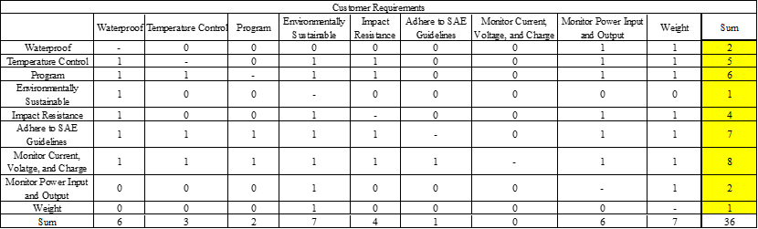
Comparison Matrix

Slide 41
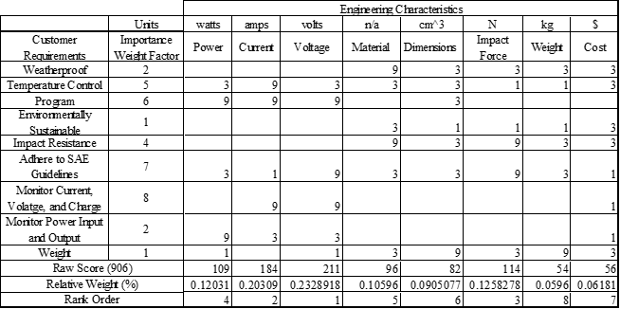
House of Quality

Slide 42
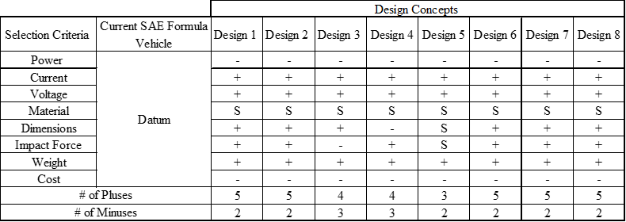
Nine-Design Pugh Chart

Slide 43
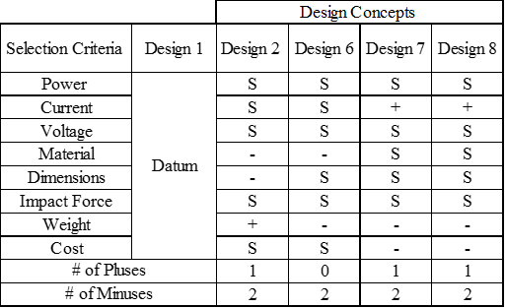
Five-Design Pugh Chart

Slide 44
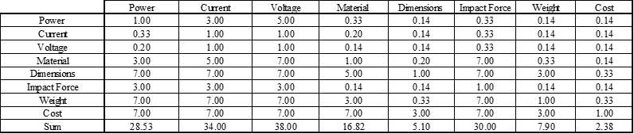
Analytical Hierarchy Process

Slide 45
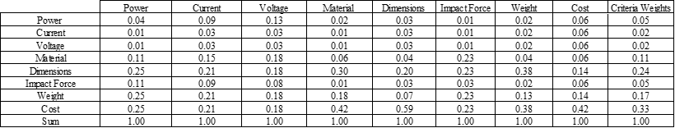
Analytical Hierarchy Process Normalized

Slide 46
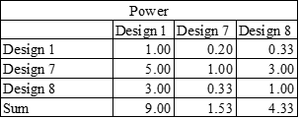
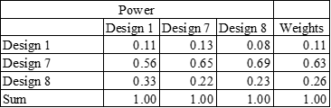
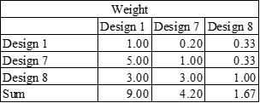
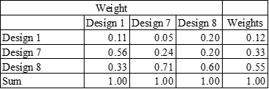
Analytical Hierarchy Process (cont.)

Slide 47
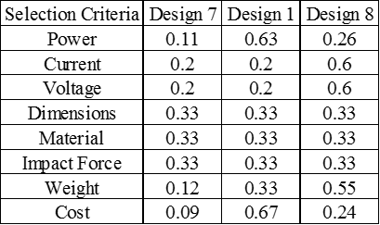
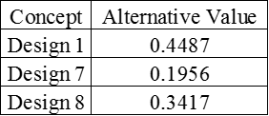
Analytical Hierarchy Process (cont.)

Slide 48

Air intake Hydro shield
Acts as a prefilter
Rejects any particle ~0.005”
Inexpensive
Easy to install

Slide 49
Detailed Math Backup

Slide 52
Standard Shapes
Summary Box
Text box 1
Outlined Text Box

Slide 53




Approved Logos

Slide 54
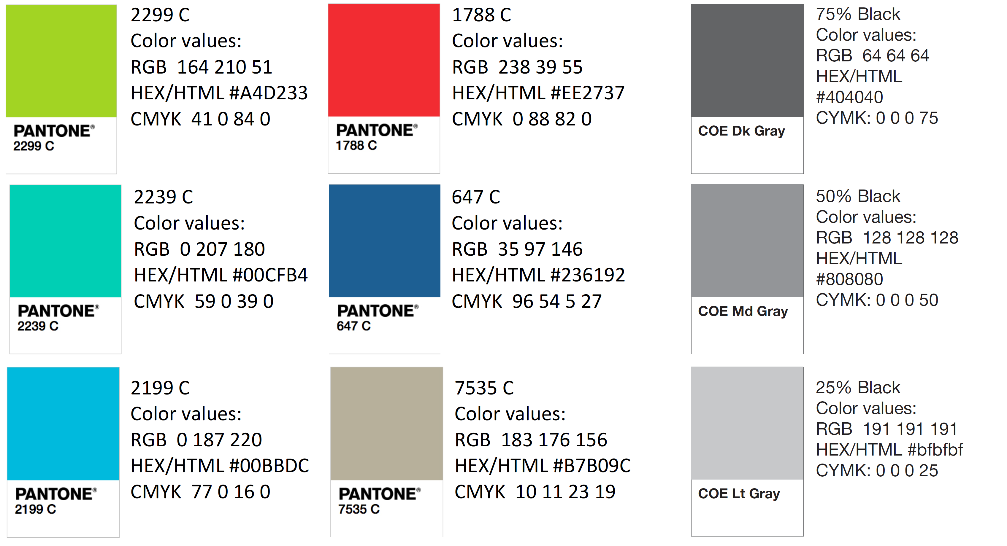
Color Palette

Slide 55
APA Tables
Category 1 | Category 2 | Category 3 | Category 4 | Category 5
Item 1
Item 2
Item 3
Item 4
 | Category 2 |  |  | Category 3
Category 1 | subcategory 1 | subcategory 2 |  | subcategory 1 | subcategory 2
Item 1
Item 2
Item 3
Item 4

